Slide 1
Practical RL – Week 2
Shvechikov Pavel
Notes:
Welcome to week 2 of the Reinforcement learning course!
During this week we will talk about core concepts lying in the heart of Reinforcement learning.

Slide 2
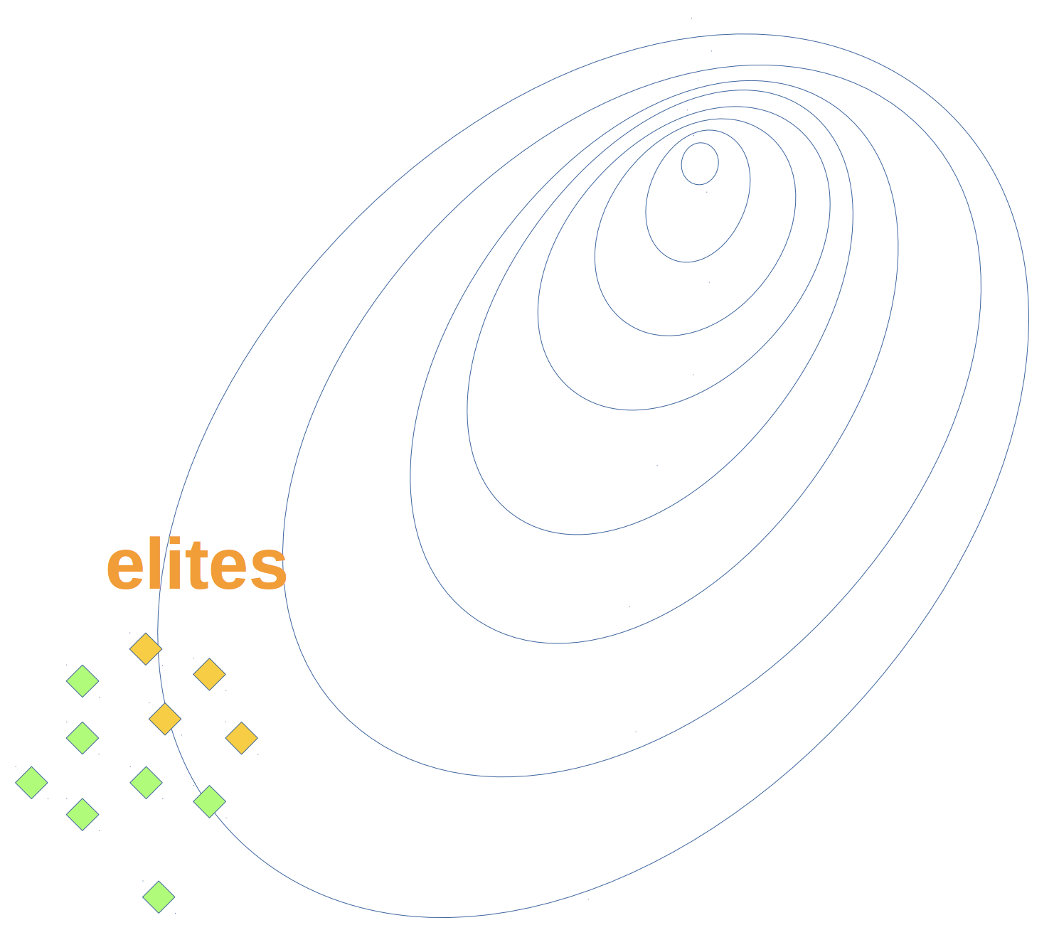
Previously in the course
The MDP formalism
State, Action, Reward, next State
Cross-Entropy Method (CEM)
easy to implement, good results
rich theoretical background
black box
no knowledge of environment
no knowledge of intermediate rewards
Improve on the CEM → dive into the black box

Slide 3
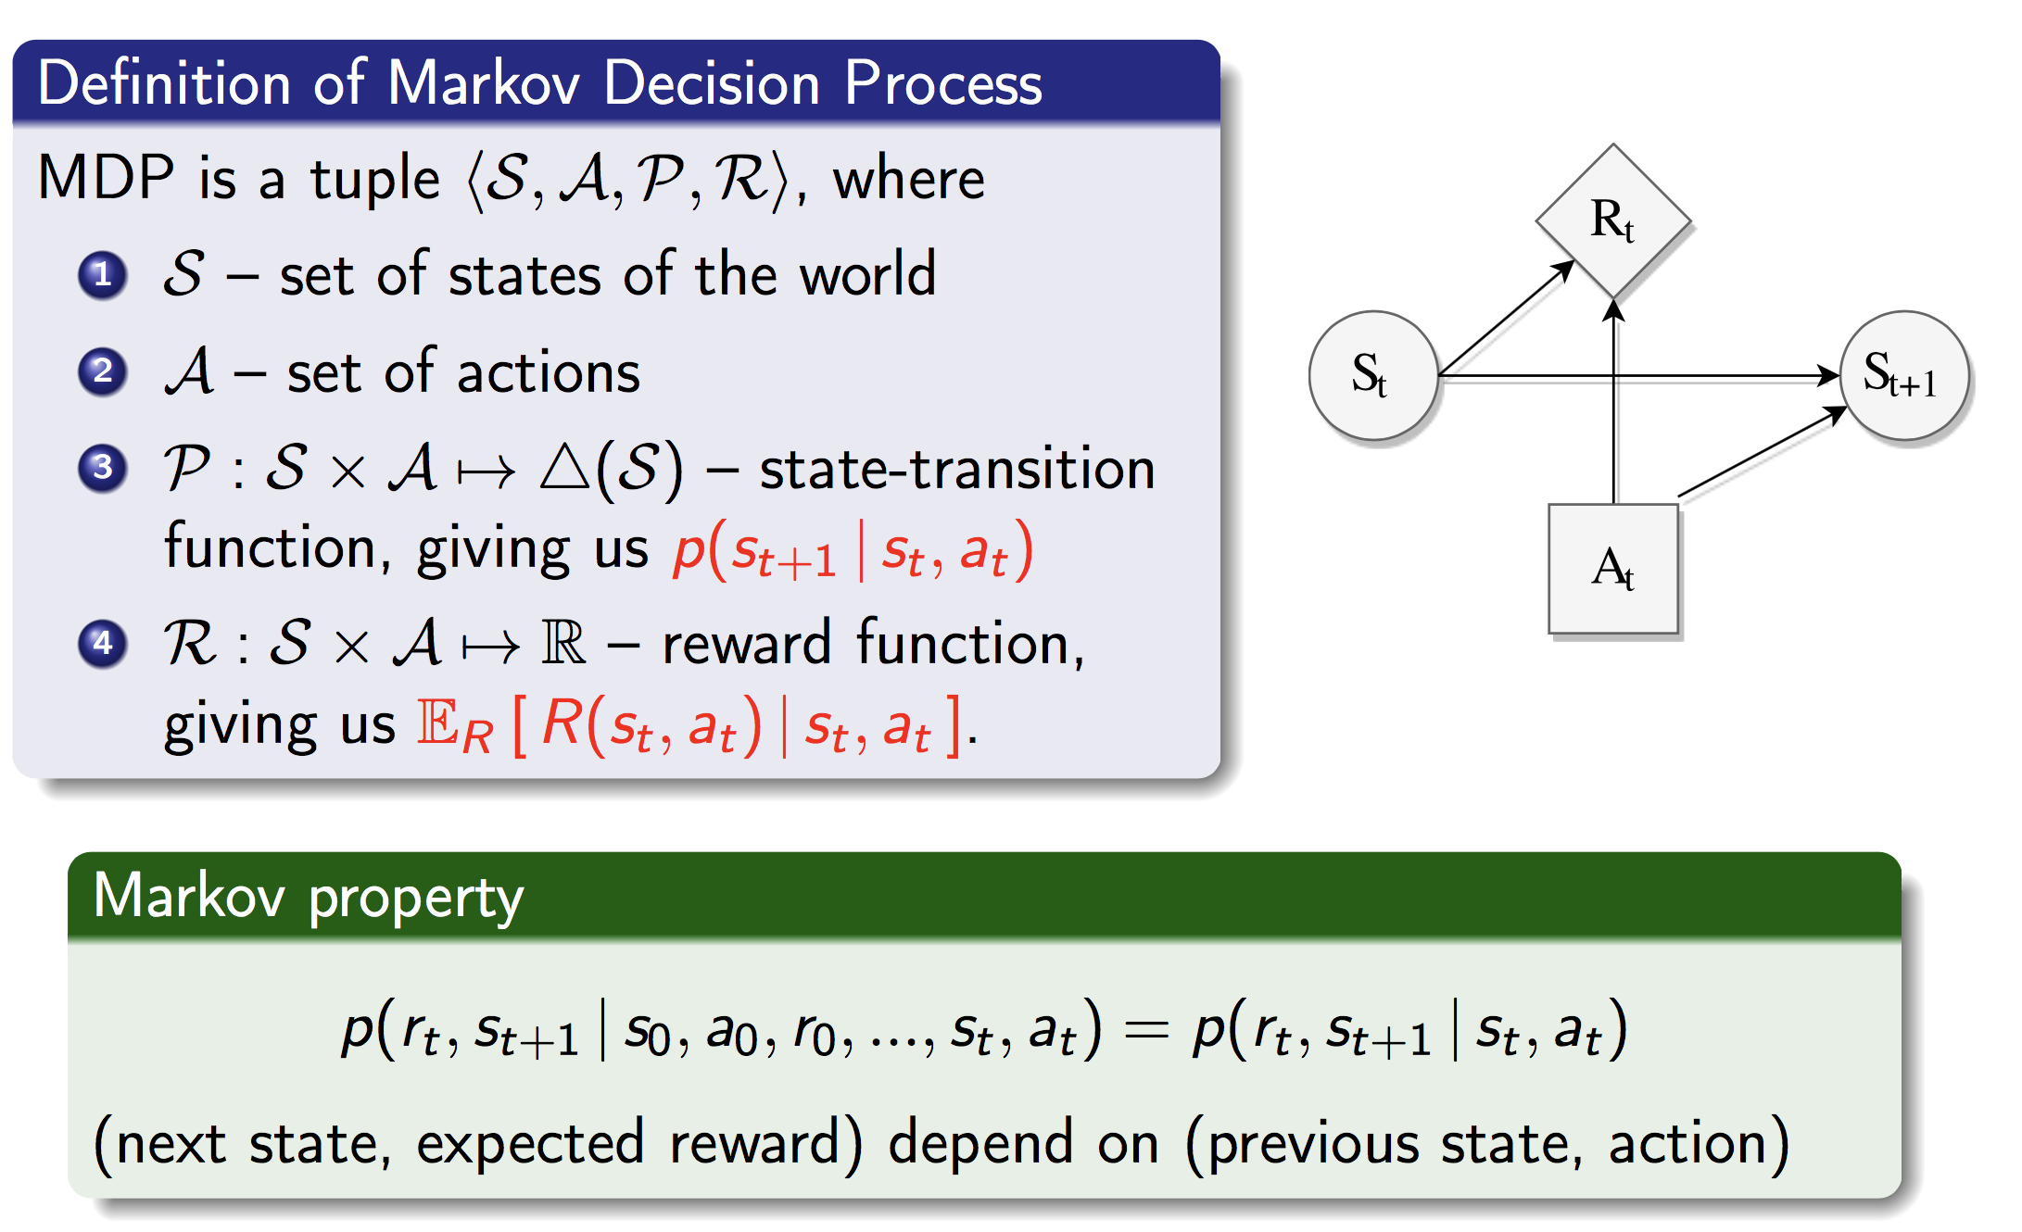
Given dynamics, how to find an optimal policy?

Slide 4
Goal: solve an MDP by finding an optimal policy
What is the objective?
Reward: discounting and design
Expected objective: state- and action-value function
How to evaluate the objective?
Bellman expectation equations
How to improve the objective?
Bellman optimality equations
Combine evaluation and improvement:
Generalized Policy Iteration

Slide 5
Explaining goals to agent through reward
Reward hypothesis (R.Sutton)
Goals and purposes can be thought of as the maximization of the expected value of the cumulative sum of a received scalar signal
Notes:
How to explain to agent, what do we want it to do?
The answer to this question is reward hypothesis, which states that we could formulate any goal and purpose in terms of cumulative sum of a scalar signal.
This signal is called reward and the sum of this signal over time is called a return.

Slide 6

Explaining goals to agent through reward
Reward hypothesis (R.Sutton)
Goals and purposes can be thought of as the maximization of the expected value of the cumulative sum of a received scalar signal
Сumulative reward is called a return:
E.g.: reward in chess – value of taken opponent's piece
Notes:
So the return G sub t is a sum of immediate rewards from arbitrary time t and till the very end of the episode, denoted by capital T.
This return consists of all rewards till the end of the episode and thus is a measure of global optimality of agent policy.

Slide 7
Explaining goals to agent through reward
Reward hypothesis (R.Sutton)
Goals and purposes can be thought of as the maximization of the expected value of the cumulative sum of a received scalar signal
Сumulative reward is called a return:
end of an episode
immediate reward
E.g.: reward in chess – value of taken opponent's piece
Notes:
Return is a random variable, because each immediate reward depends on the agent action and also on the environment reaction to this action.
We will adress the issue of randomness a bit later. For now, consider the example – the game of chess.
Let assume that we have designed the immediate reward to be a value of opponent piece taken at the particular time step t.
So the return is equal to the total value of all opponent pieces an agent have managed to take till the end of the game.
Although mathematically convenient such formulation of our desire could have side effects.

Slide 8
E.g.: data center non-stop cooling system
States – temperature measurements
Actions – different fans speed
R = 0 for exceeding temperature thresholds
R = +1 for each second system is cool
What could go wrong with such a design?
Notes:
To better understand the limitations of cumulative sum of immediate rewards, consider another example of data center non stop cooling system.
An agent controls temperature in a data center room and could adjust speed of different fans to enforce required temperature regime.
We reward this agent with +1 for each second the system’s temperature was sufficiently low and give it reward equal to 0 otherwise.
Can you think of any possible problem in such a design?

Slide 9
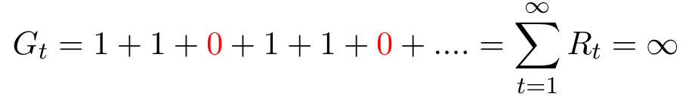
E.g.: data center non-stop cooling system
States – temperature measurements
Actions – different fans speed
R = 0 for exceeding temperature thresholds
R = +1 for each second system is cool
What could go wrong with such a design?
Infinite return for non optimal behaviour!
Notes:
Well, the problem here is in the length of the episode. Unlike the chess game this task does not have natural ending. That is, cooling system is meant to operate well in every day of the week, every single moment and operate in that way forever. The essence of the problem with infinite horizon lies inoptimization problem. That is, our objective, our return is infinite for a myriad of non optimal behaviors! For instance, it is indeed infinte for an agent behavior that violates temperature regime at every third time step! Tasks with infinite horizon are called continuing tasks.
Of course, we could split such infinite horizon in some fixed length chunks (for example, hours, or days) and assess agent performance on the basis of performance during these chunks. However this approach requires manual decisions of what chunk length is appropriate and does not generalize well to arbitrary problem. Nevertheless, Infinite horizon is not the only problem which may occur with this formulation of return.

Slide 10
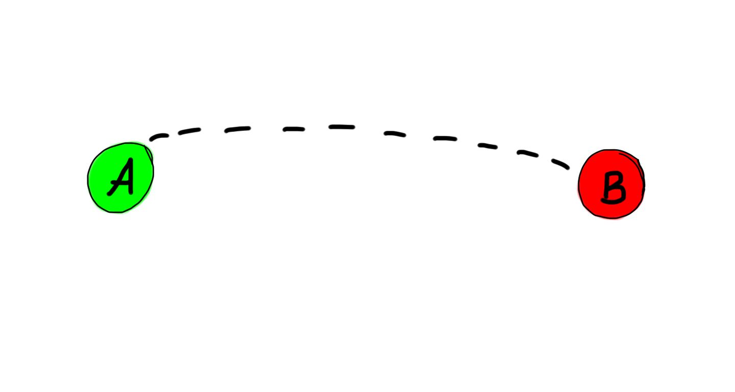

E.g.: moving to destination
State – position, velocities of joints
Actions – actuator forces to joints
R = max(0, d(x, B) - d(x’, B))
What could go wrong with such a design?
Notes:
To better understand another problem with cumulative sum of rewards consider the example of an agent, responsible for floor cleaning and air conditioning in a building. So, we encourage our agent to clean a floor by rewarding cleaning action with large value of 100. But, because we also want air in that building to be fresh we also encourage an agent for turning air conditioning system on and subsequently off with the reward equal to 1.
For this example there is no infinite horizon because episode ends when a day is over. So what potential problems do you see in such a design?
_pause_
Well, this example illustrates the problem of positive feedback loop.

Slide 11
E.g.: moving to destination
State – position, velocities of joints
Actions – actuator forces to joints
R = max(0, d(x, B) - d(x’, B))
What could go wrong with such a design?
R > 0
R = 0
Positive feedback loop!
Notes:
To better understand another problem with cumulative sum of rewards consider the example of an agent, responsible for floor cleaning and air conditioning in a building. So, we encourage our agent to clean a floor by rewarding cleaning action with large value of 100. But, because we also want air in that building to be fresh we also encourage an agent for turning air conditioning system on and subsequently off with the reward equal to 1.
For this example there is no infinite horizon because episode ends when a day is over. So what potential problems do you see in such a design?
_pause_
Well, this example illustrates the problem of positive feedback loop.

Slide 12
Reward discounting
Notes:
Well, by now, the one thing is not completely clear.
When we were talking about a solution to the system of bellman expectation equations I said that most of the time we don’t need the precise solution of this system. It is sufficient for us to obtain a good approximation to the solution. Why is it so?
Let look at the small grid world problem

Slide 13

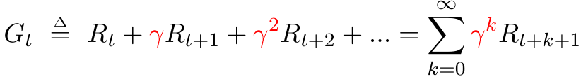




Reward discounting
Get rid of infinite sum by discounting
discount factor
The same cake compared to today’s one worth
times less tomorrow
times less the day after tomorrow
will eat it day by day
Notes:
One of the most common approaches is discounting.
Discounting means that we introduce some multiplier gamma which is less then one and greater or equal to zero.
This multiplier represents the rate with which things lose their value.
That is, each reward received later then current moment t is reduced by multiplying the reward with the gamma to the power of number of time steps to this return.
So, discounting focuses agent's attention more on close rewards, and reduce the value of very distant ones.
More informally, the same cake compared to today’s one worth
Gamma times less tomorrow
Gamma squared times less the day after tomorrow and so on.
So that reward received in n time steps in the future is worth `gamma to the power of (n-1)` times less compared with the same reward obtained right now.
Such discounting allows to make infinite sum finite, provided that each term in a sum is bounded both from above and below.
Well, why does this discounting solves the problem of return being infinite?

Slide 14
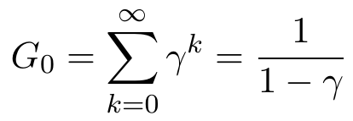

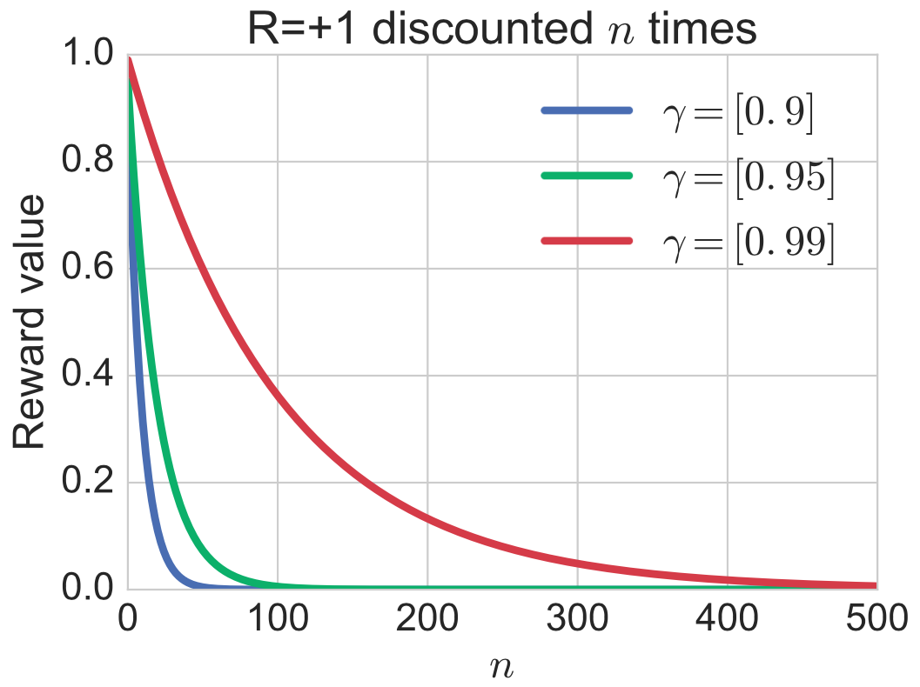

Discounting makes sums finite
Maximal return for R = +1
 | 0.9 | 0.95 | 0.99
 | 10 | 20 | 100
Notes:
This is so, because of mathematical property of Geometric progression.
So for example if each immediate reward is equal to one (as in example with data center cooling system), then infinite sum is equal to the value of 1 over 1 - gamma.
Maximal return have nothing to do with the number of steps after which agent does not care.
This value is sometimes called effecitve horizon.
On the plot you can see what a reward of +1 would be equal to after being discounted n times with different gammas.
Note that slope of any curve decreases while increasing n.
This decrease suggests that events in the near future are discounted at a higher discount rate than events in the distant future.
Also, note, that in case gamma is not exactly equal to zero, every reward, even infinitely distant one, contributes to the return computation. It may contribute very very little (for very distant rewards), but it certainly does so. That is our agent still cares about distant rewards, but not as much as in case of undiscounted return.
However, you should understand, that agent will be almost indifferent to the very distant rewards and this change of optimization objective definitely change what optimal policy looks like in each of these cases.
__question__
Why is the discounting meaningful thing to do?
How does it relates with human preferences?
What is the intuitive explanation of discounting?
This point each reward contributing to return makes discounting less criminal, but gives too little

Slide 15
Discounting makes sums finite
Maximal return for R = +1
 | 0.9 | 0.95 | 0.99
 | 10 | 20 | 100
Any discounting changes optimisation task and its solution!
Notes:
This is so, because of mathematical property of Geometric progression.
So for example if each immediate reward is equal to one (as in example with data center cooling system), then infinite sum is equal to the value of 1 over 1 - gamma.
Maximal return have nothing to do with the number of steps after which agent does not care.
This value is sometimes called effecitve horizon.
On the plot you can see what a reward of +1 would be equal to after being discounted n times with different gammas.
Note that slope of any curve decreases while increasing n.
This decrease suggests that events in the near future are discounted at a higher discount rate than events in the distant future.
Also, note, that in case gamma is not exactly equal to zero, every reward, even infinitely distant one, contributes to the return computation. It may contribute very very little (for very distant rewards), but it certainly does so. That is our agent still cares about distant rewards, but not as much as in case of undiscounted return.
However, you should understand, that agent will be almost indifferent to the very distant rewards and this change of optimization objective definitely change what optimal policy looks like in each of these cases.
__question__
Why is the discounting meaningful thing to do?
How does it relates with human preferences?
What is the intuitive explanation of discounting?
This point each reward contributing to return makes discounting less criminal, but gives too little

Slide 16
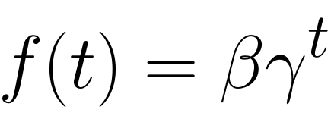
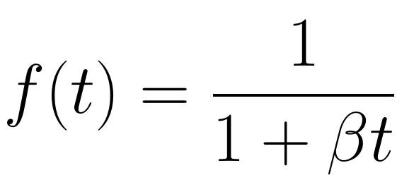
Discounting is inherent to humans
Quasi-hyperbolic
Hyperbolic discounting
Laibson, D. (1997). Golden eggs and hyperbolic discounting. The Quarterly Journal of Economics, 112(2), 443-478.
Notes:
Well, the reason of discounting is partially mathematical convenience and partially inspiration from human behaviour.
Humans, just like animals, given two similar rewards, show a preference for the one that arrives sooner rather than later.
Humans also discount the value of the later reward, by a factor that increases with the length of the delay. However, scientific literature suggest, that human and animal discounting function f(t) is different and is more like hyperbolic discounting.
This discounting function f(t) used in RL is equal to beta times gamma to the power of t in case of quasi-hyperbolic discounting with beta equal to one.
Well, this is precisely the same discounting scheme you have been shown on previous slide.
In some sense thiss quasi-hyperbolic discounting is a discrete approximation to a hyperbolic discounting function.

Slide 17
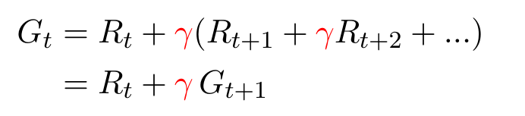
Discounting is inherent to humans
Quasi-hyperbolic
Hyperbolic discounting
Mathematical convenience
Remember this one!
We will need it later
Laibson, D. (1997). Golden eggs and hyperbolic discounting. The Quarterly Journal of Economics, 112(2), 443-478.
Notes:
The second reason of this particular kind of discounting is mathematical convenience.
It is not only makes infinte sums finite, preserves some amount of contribution for each reward, but it also allows to express the return in a recurrent fashion.
We will heavily rely upon this recursive definition of Gt through Rt + gama multiplied by G_t+1 in future lections.
So make sure, you understand and remember it.

Slide 18
Discounting is a stationary end-of-effect model
Any action affects (1) immediate reward (2) next state
Notes:
One could also think about discounting from a different, more theoretical perspective.
Under markov assumption, any action affects only the immediate reward and the next state.
_ вопрос _

Slide 19
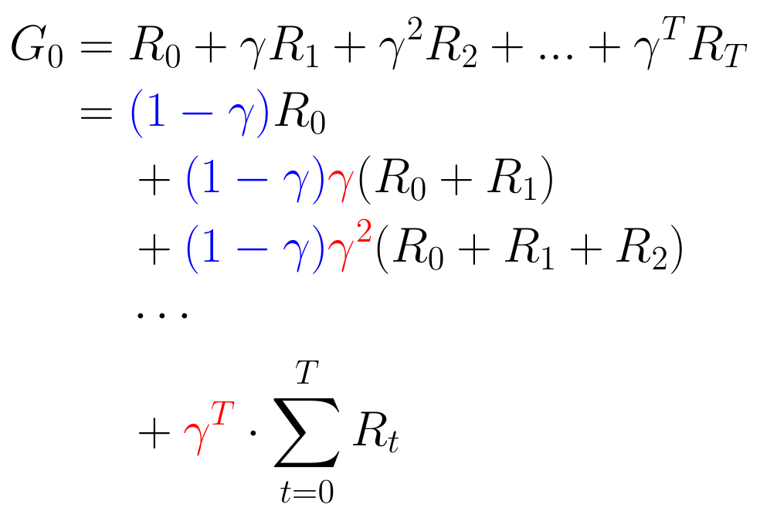
Discounting is a stationary end-of-effect model
Any action affects (1) immediate reward (2) next state
Action indirectly affects future rewards
But how long does this effect lasts?
G is expected return under stationary end-of-effect model
Notes:
Well, any action could affect all or some of the future rewards by affecting the next state. That is, when you find a treasure in cornen of the room, you definitely should assign some credit related to this reward to the action of openening the door to this room.
So, let assume that the action effect lasts some consequent number of steps after the action was committed and then ends.
Let us also treat gamma as probability of effect continuation and (1-g) as probability that effect ends.
Then the expected amount of return which is due to current action is exactly equal to the discounted return.

Slide 20
Discounting is a stationary end-of-effect model
Any action affects (1) immediate reward (2) next state
Action indirectly affects future rewards
But how long does this effect lasts?
“Effect continuation” probability
“End of effect” probability
G is expected return under stationary end-of-effect model
Notes:
That is, with probability (1-gamma) effect ends immediately and only the immediate reward R0 is attributed to the action commited now.
With probability gamma effect lasts two time steps and then ends with probability (1-gamma). Iin this case R0 and R1 are attributed to current action.
And so on, you get the idea.

Slide 21
Reward design – don’t shift, reward for WHAT
E.g.: chess – value of taken opponent's piece
Problem: agent will not have a desire to win!
E.g.: moving to destination
Problem: agent will not bother about the goal!
Notes:
Let us now speak a little bit about reward design. Two examples given in this lecture are in fact examples of a bad reward design.
Consider for example the game of chess and reward equal to the value of taken opponent piece.
In this case an agent will not have a desire to win, becuase it knows for sure that it will not be rewarded !
And in the cleaning robot example it will also ignore the reward given for cleaning the floor.
Two these examples share the same mistake – in both of them reward is given for HOW an agent should perform it’s duties. And not for WHAT do we want it to do.
In the game of chess we should reward an agent for WINNING the game and NOT for taking pieces. Because the latter could simply result in losing every single game with a lot of opponent’s pieces taken. That is surely not what we want.
The same is valid for the second example. We should reward an agent for fresh air and clean floor. But not for using the means to achieve these!
However such sparse rewards, given only in the very end of an episode (+1 in the chess game for winning) may introduce additional dificulties in agent’s learning.
To some extent this may be mitigated by reward shaping, which we will discuss a little bit later.

Slide 22
Reward design – don’t shift, reward for WHAT
E.g.: chess – value of taken opponent's piece
Problem: agent will not have a desire to win!
E.g.: moving to destination
Problem: agent will not bother about the goal!
Take away: reward only for WHAT, but never for HOW
- 9
-1
S2
S1
S4
-1
-1
End
Start
S3
Notes:
The next concern is about reward shifting. In the machine learning courses you may get used to standardize training and testing data before doing anything with this data. Well, for example, mean subtraction and division by standard deviation is often a good idea in supervised and unsupervised learning.
In reinforcement learning this is valid only for state representations, but NOT for reward. You should not standardize rewards!
Let us see what will happen with optimal policy if you shift all the rewards by some mean value.
Consider the world with 4 states. An episode starts in S1, and ends in S4. Rewards for transitions are written above the arrows.
In the following example mean of the rewards will be negative, say -3, and subtraction of this value will turn negative feedback loop within states S2-S3 into positive feedback loop. Optimal policy for the world with modified rewards will definitely make use of this positive feedback loop. However, in the world with untransformed reward this policy will get possibly unboundedly bad return.

Slide 23
Reward design – don’t shift, reward for WHAT
E.g.: chess – value of taken opponent's piece
Problem: agent will not have a desire to win!
E.g.: moving to destination
Problem: agent will not bother about the goal!
Take away: reward only for WHAT, but never for HOW
- 9
-1
S2
Take away: do not subtract mean from rewards
S1
S4
-1
-1
End
Start
S3
Notes:
So the second take away is – do not subtract anything from rewards, unless you are pretty sure what you are doing.

Slide 24

Faulty reward functions
Reward for ball possession in soccer
Vibrating near the ball
Cyclic behaviours

Slide 25
Reward design – scaling, shaping
What transformations do not change optimal policy?
Reward scaling – division by positive constant
May be useful in practise for approximate methods
Ng, A. Y., Harada, D., & Russell, S. (1999, June). Policy invariance under reward transformations: Theory and application to reward shaping. In ICML (Vol. 99, pp. 278-287).

Slide 26
Reward design – scaling, shaping
What transformations do not change optimal policy?
Reward scaling – division by positive constant
May be useful in practise for approximate methods
Reward shaping – add a potential-based shaping function F(s, a, s’):
Intuition: when no discounting F adds as much as it subtracts from the total return
Ng, A. Y., Harada, D., & Russell, S. (1999, June). Policy invariance under reward transformations: Theory and application to reward shaping. In ICML (Vol. 99, pp. 278-287).

Slide 27
Expected objective
Notes:
Well, by now, the one thing is not completely clear.
When we were talking about a solution to the system of bellman expectation equations I said that most of the time we don’t need the precise solution of this system. It is sufficient for us to obtain a good approximation to the solution. Why is it so?
Let look at the small grid world problem

Slide 28
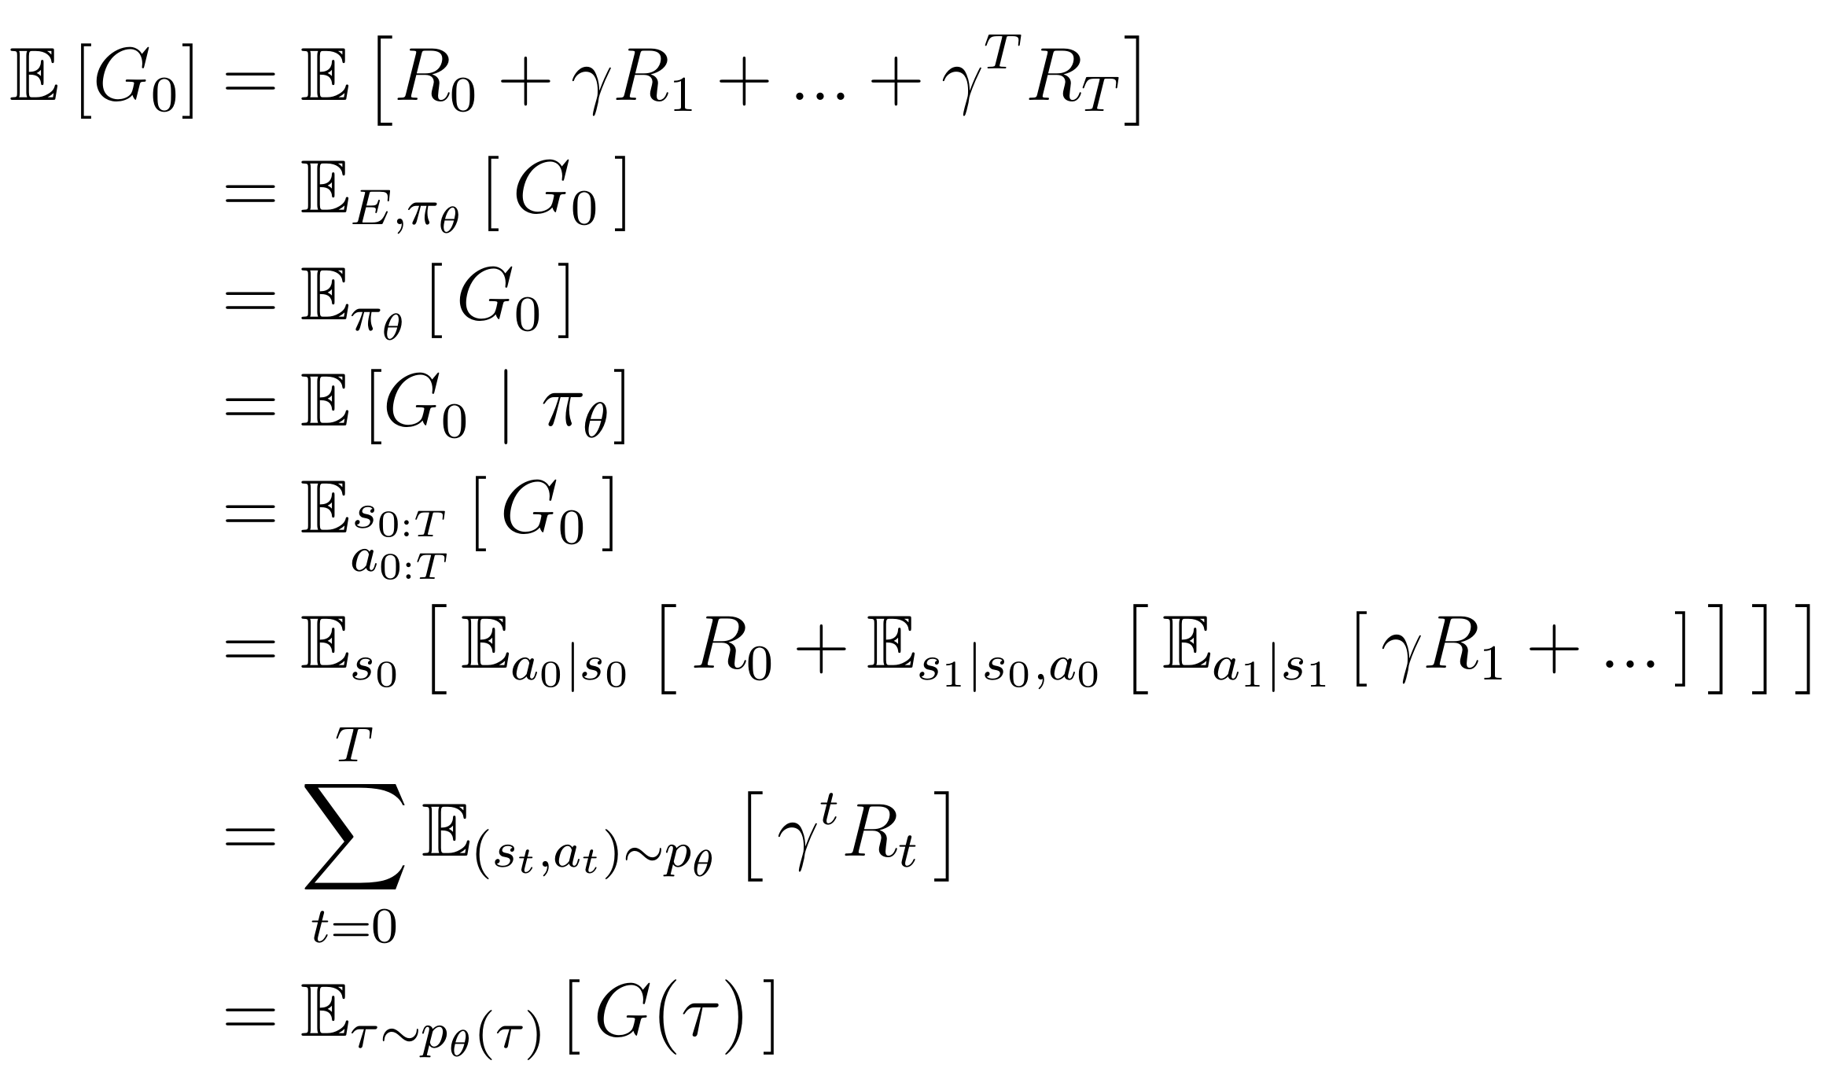
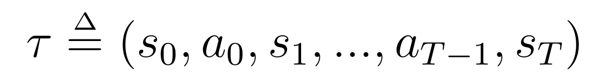
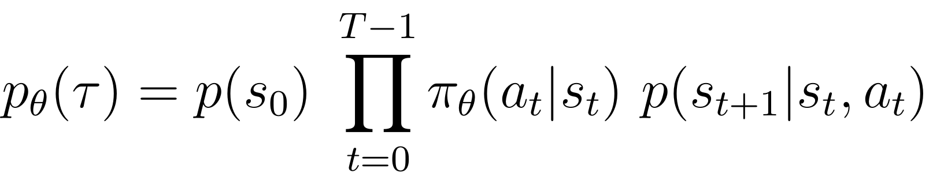
Optimal policy maximizes expected return
Notes:
Taking expectation
So that leads us directly to the notion of State-value function, v(s).
Today we will cover the model-based approach

Slide 29





Backup Tree: how to find an optimal policy?
. . .

Slide 30
State- and Action-value functions
Notes:
Well, by now, the one thing is not completely clear.
When we were talking about a solution to the system of bellman expectation equations I said that most of the time we don’t need the precise solution of this system. It is sufficient for us to obtain a good approximation to the solution. Why is it so?
Let look at the small grid world problem

Slide 31
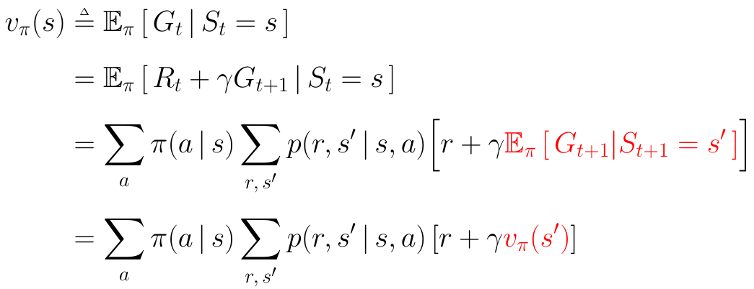

State-value function v(s)
v(s) is expected return conditional on state:
Intuition: value of following policy from state s

Slide 32
State-value function v(s)
v(s) is expected return conditional on state:
stochasticity in policy & environment
Intuition: value of following policy from state s

Slide 33
State-value function v(s)
v(s) is expected return conditional on state:
stochasticity in policy & environment
Environment stochasticity
Policy stochasticity
Intuition: value of following policy from state s

Slide 34
State-value function v(s)
v(s) is expected return conditional on state:
stochasticity in policy & environment
Environment stochasticity
Policy stochasticity
By definition
Intuition: value of following policy from state s

Slide 35
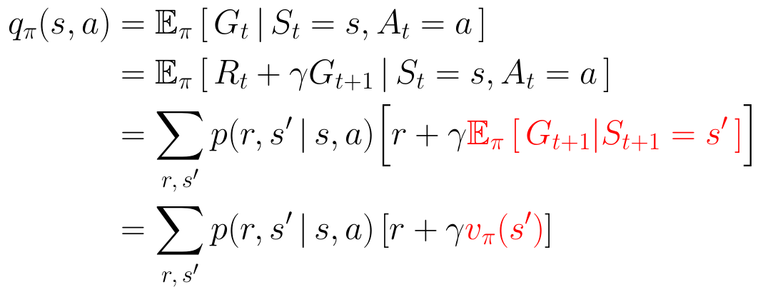
Action-value function q(s, a)
Is expected return conditional on state and action:
Intuition: value of following policy after committing action a in state s
Notes:
Again, what we care about is global optimality which we have formulated so far in terms of return.
However, return is a random variable – because our policy may be stochastic and
The last term is a linear equation in V(s) For each state we could write V(s) in terms
Intuition of the state-value function

Slide 36
Action-value function q(s, a)
Is expected return conditional on state and action:
Intuition: value of following policy after committing action a in state s
No policy stochasticity at first step
Notes:
Again, what we care about is global optimality which we have formulated so far in terms of return.
However, return is a random variable – because our policy may be stochastic and
The last term is a linear equation in V(s) For each state we could write V(s) in terms
Intuition of the state-value function

Slide 37
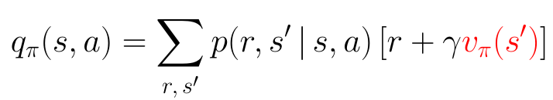
Relations between v(s) and q(s,a)
We already know how to write q(s,a) in terms of v(s)
What about v(s) in terms of q(s,a)?
Notes:
Again, what we care about is global optimality which we have formulated so far in terms of return.
However, return is a random variable – because our policy may be stochastic and
The last term is a linear equation in V(s) For each state we could write V(s) in terms
Intuition of the state-value function

Slide 38
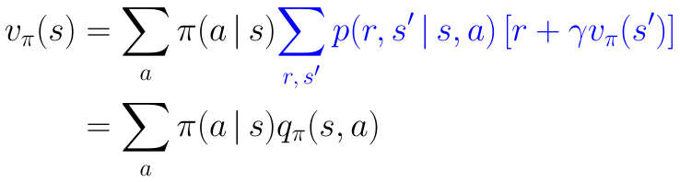
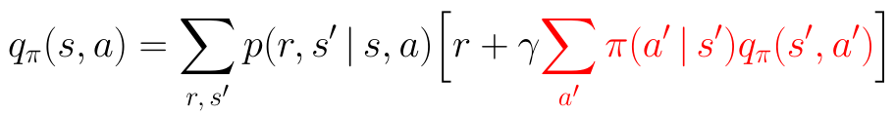
Relations between v(s) and q(s,a)
We already know how to write q(s,a) in terms of v(s)
What about v(s) in terms of q(s,a)?
So, we could now write q(s, a) in terms of q(s,a)!
Notes:
Again, what we care about is global optimality which we have formulated so far in terms of return.
However, return is a random variable – because our policy may be stochastic and
The last term is a linear equation in V(s) For each state we could write V(s) in terms
Intuition of the state-value function

Slide 39
Bellman expectation equations
Notes:
Well, by now, the one thing is not completely clear.
When we were talking about a solution to the system of bellman expectation equations I said that most of the time we don’t need the precise solution of this system. It is sufficient for us to obtain a good approximation to the solution. Why is it so?
Let look at the small grid world problem

Slide 40
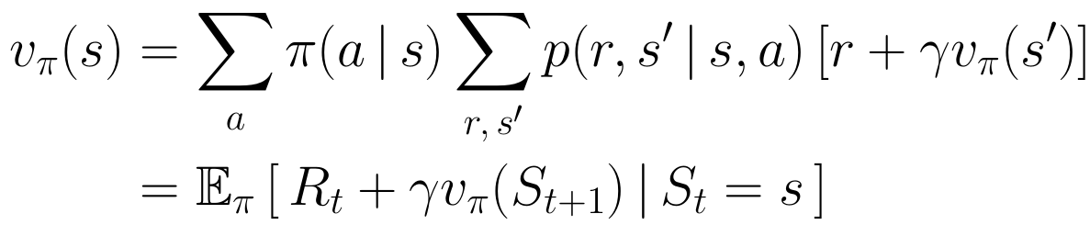
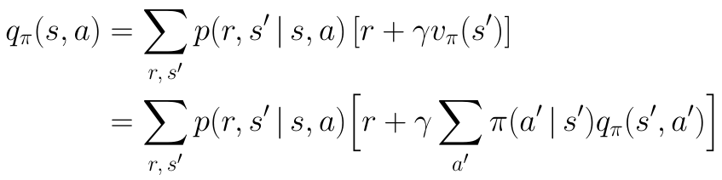
Bellman expectation equations
For v(s):
For q(s, a):
Notes:
It expresses a relationship between the value of a state and the values of its successor states.
Think of looking ahead from one state to its possible successor states.
Why does it called backup? The value functino v_pi is the unique solution to its Bellman equation

Slide 41
What do we gonna do with value functions?
Already know
Return, value- and action-value functions
Bellman equations – assess policy performance
Optimal policy makes
best actions in each possible state
But how to know which policy is better?
How to compare them?
Notes:
Cool!
Now we know how to compute policy values for each state.
We know what is return, what is value- and action-value functions.
But we started with a desire to find optimal policy! That is – to know optimal actions in every state.
Before deciding which policy is the best one, we should decide about how to compare policies?

Slide 42
Bellman optimality equations
Notes:
Well, by now, the one thing is not completely clear.
When we were talking about a solution to the system of bellman expectation equations I said that most of the time we don’t need the precise solution of this system. It is sufficient for us to obtain a good approximation to the solution. Why is it so?
Let look at the small grid world problem

Slide 43

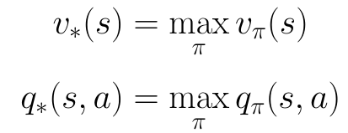
Optimal policy is the one with the largest v(s)
We could compare policies on the basis of v(s)
Best policy is better or equal to any other policy
Use optimal policy from s
In any finite MDP there is always at least one deterministic optimal policy
Commit action a, and afterwards use optimal policy
Notes:
_ question about discounted and non discounted reward _
There could be many optimal policies
Again we would like to reformulate this recursive

Slide 44






Bellman optimality equation for v(s)
Bellman expectation equation for v(s)
Bellman optimality equation for v*(s)
Notes:
On the slide there are backup diagram for expectation equation on the left and its copy on the right which we are going to modify in a way that will allow to compute _optimal_ value function.
Now think for a moment what do we need to modify in this backup diagram? We already know that there exist at least one deterministc policy which is optimal.
So it suffice to select only one optimal action in each state to be globally optimal. We don’t need to take an expectation.
And again, value
It suffice to take only the best one. And this action is selected because it corresponds to the best value, that is the maximal value of the subtree.

Slide 45

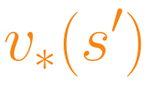
Bellman optimality equation for v(s)
max
Bellman expectation equation for v(s)
Bellman optimality equation for v*(s)

Slide 46
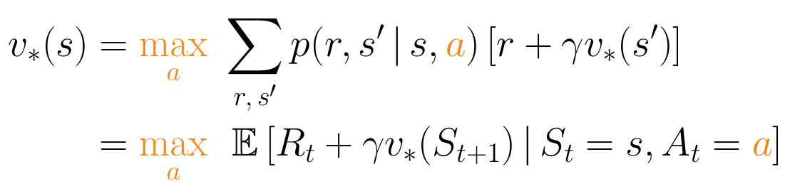
Bellman optimality equation for v(s)
max
Bellman expectation equation for v(s)
Bellman optimality equation for v*(s)

Slide 47


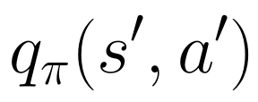

Bellman optimality equation for q(s,a)
Bellman expectation equation for q(s,a)
Bellman optimality equation for q*(s, a)

Slide 48


Bellman optimality equation for q(s,a)
max
max
Bellman expectation equation for q(s,a)
Bellman optimality equation for q*(s, a)

Slide 49
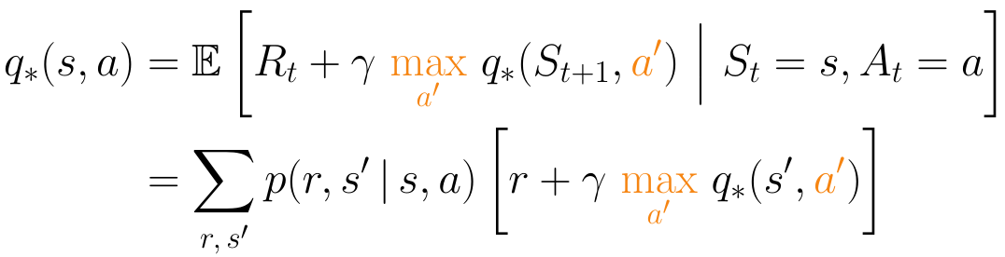
Bellman optimality equation for q(s,a)
max
max
Bellman expectation equation for q(s,a)
Bellman optimality equation for q*(s, a)

Slide 50
Bellman equations: operator view
Notes:
Well, by now, the one thing is not completely clear.
When we were talking about a solution to the system of bellman expectation equations I said that most of the time we don’t need the precise solution of this system. It is sufficient for us to obtain a good approximation to the solution. Why is it so?
Let look at the small grid world problem

Slide 51
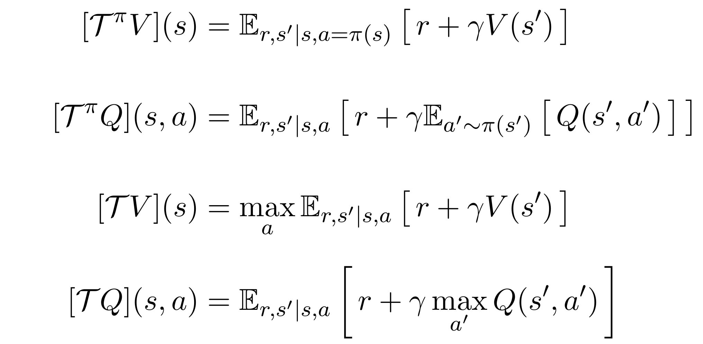
Bellman equations: operator view

Slide 52
Bellman equations: operator view
Bellman expectation equation for v(s)
Bellman expectation equation for q(s,a)
Bellman optimality equation for v*(s)
Bellman optimality equation for q*(s,a)

Slide 53
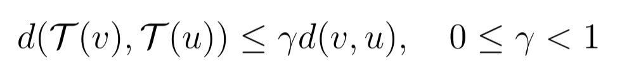
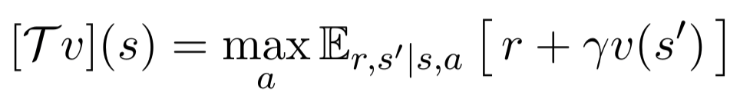

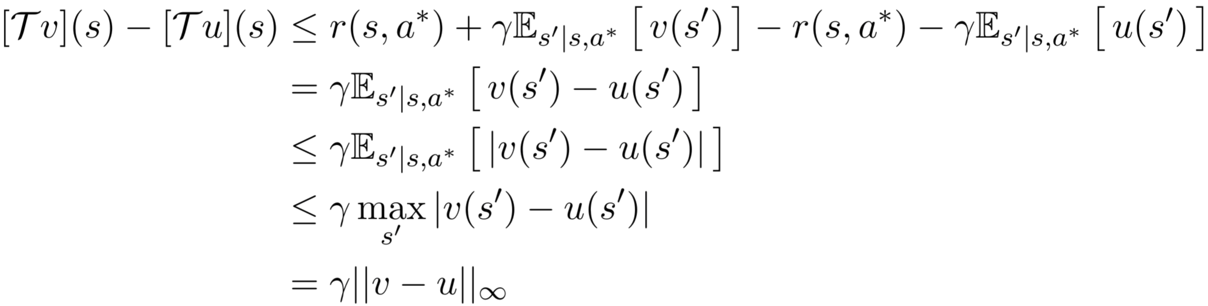

Bellman equations are contractions
Contraction:
Operator:
Denote , then, for any s:
Hence, taking max over s:

Slide 54
Generalized Policy Iteration:
Policy Evaluation
Policy Improvement
Notes:
Well, by now, the one thing is not completely clear.
When we were talking about a solution to the system of bellman expectation equations I said that most of the time we don’t need the precise solution of this system. It is sufficient for us to obtain a good approximation to the solution. Why is it so?
Let look at the small grid world problem

Slide 55
Policy evaluation
Notes:
Well, by now, the one thing is not completely clear.
When we were talking about a solution to the system of bellman expectation equations I said that most of the time we don’t need the precise solution of this system. It is sufficient for us to obtain a good approximation to the solution. Why is it so?
Let look at the small grid world problem

Slide 56
Policy evaluation: motivation
If you can't measure it, you can't improve it. Peter Drucker
Policy evaluation is also a called prediction problem:
predict value function for a particular policy.
Bellman expectation equation
is basically a system of linear equations where
# of unknowns = # of equations = # of states
Notes:
Is basically a set of linear equations where there are as many unknowns as there are states v(s).
So we could solve this system of linear equations with respect to v( of each s), but it could take us too much time to compute for a problems with medium number of states.
However most of the time we don't want to solve this system precisely.
Another approach is to use iterative method to solve this system which is proven to converge for any MDP and any policy to unique solution on v(s)
(1) initialize randomly value function for each state
(2) compute right hand side
(3) assign it to v(s)
(4) repeat for each state until convergence
For now consider another approach which is an iterative one.
we could get compute we could start with a random initializations of a function for each state then we can compute the right-hand side of bellmen expectation equation and then assign this computers value of right-hand side to the left-hand side and we could repeat this process of computing right hand side and assigning this right hand side value to the left-hand side until value functions do not change or change sufficiently little this iterative approach is proven to converge for any marker decision process and any policy - Aniki solution on value fashion and this this approach in fact allows us to obtain an approximate solution in a rather fast way and this is what we care about in fact the informal statement of when to terminate this policy valuation algorithm could be made a little bit more formal where the notion of delta which is a maximum increment in Bury function over all possible states made in this iteration now you know how to compute the value function for each state under given policy PI but again this is not what we really want to we want to find an optimal policy and however we cannot guess what an optimal policy is and instead of random guessing we adhere to gradually improving current policy PI and on each iteration we want to obtain a little bit more optimal policy

Slide 57
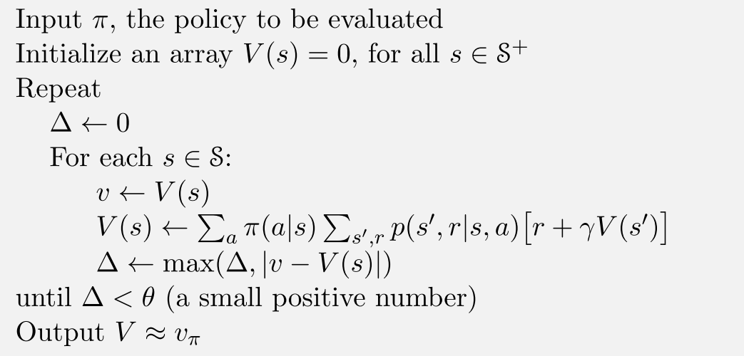
Policy evaluation: algorithm
Bellman expectation equation for v(s)
Notes:
Initialization – random, but terminal states should have Value = 0.
The essence of this algorithms is very simple – it is

Slide 58
Policy improvement
Notes:
Well, by now, the one thing is not completely clear.
When we were talking about a solution to the system of bellman expectation equations I said that most of the time we don’t need the precise solution of this system. It is sufficient for us to obtain a good approximation to the solution. Why is it so?
Let look at the small grid world problem

Slide 59
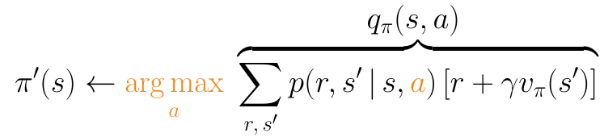
Policy improvement: an idea
Once we know what is v(s) for a particular policy
We could improve it by acting greedily w.r.t. q(s, a)!
This procedure is guaranteed to produce a better policy!
Notes:
What does it mean to act greedily wrt v(s)? In fact, what we do is
First we recover an action value function q pi from action value function v pi, which can be computed by policy evaluation algorithm, as we already know.
Second, we find an action which maximizes this action value function q pi. That is, we find what is the best possible action in state s, given that after this action we will follow policy pi.
This improvement procedure is guaranteed to produce a better policy! To obtain some intuition of why is it so, think about action value function q_pi. It tells us what expected return one could achieve after making action a in state s and following policy pi thereafter.

Slide 60


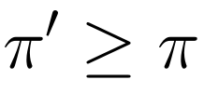
Policy improvement: an idea
Once we know what is v(s) for a particular policy
We could improve it by acting greedily w.r.t. q(s, a)!
This procedure is guaranteed to produce a better policy!
if
for all states
then
meaning that
Notes:
Our new policy pi prime in current state makes the best possible action according to the action value function of old policy pi. That is it chooses an action according to the highest expected combination of immediate reward and an old policy pi’s value function of next state.
But in this _next_ state new policy pi prime also acts greedily with respect to q pi, that is makes a better or the same decision as policy pi
The same is true about the state after the next state, and so on.
That is why value of each state of a new policy pi prime is greater or equal to the value of the same state of an old policy pi.
And thus the new policy pi’ is considered better or equal then our old policy pi.
Well this makes some sense, but what if at some step the improved new policy pi prime is actually equal to an old policy?
Is this policy in fact optimal? And why is this so?

Slide 61

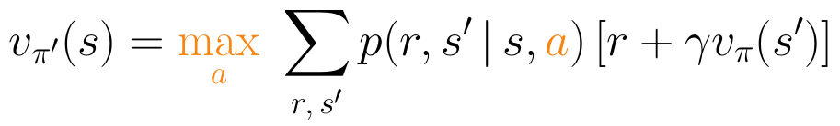
Policy improvement: convergence
If new policy after improvement
is the same as the old one
then it is optimal, since it satisfies:
Notes:
Well, if an improved policy pi prime is precisely equal to the old policy pi, that is if they recommend the same action for each and every state.
, then we conclude that this policy is optimal.
In fact, the equality of policy pi prime and pi means that their value functions are also equal.
And because during an improvement stage we assign to policy pi prime the action which maximizes the action value function, we also know what is the value of that new policy.
It is equal to action value function of state s and precisely the same action we assigned to the new policy.
That is, it’s value is equal action-value function maximized over all actions.
But this equation is a bellman optimality equation itself!

Slide 62
Policy improvement: convergence
If new policy after improvement
is the same as the old one
Bellman optimality equation
then it is optimal, since it satisfies:
Notes:
It is equal to action value function of state s and precisely the same action we assigned to the new policy.
That is, it’s value is equal action-value function maximized over all actions.
But this equation is a bellman optimality equation itself!
Well, for now we know, how to evaluate policy, how to improve it and why does this make any sense.
Let now discuss some

Slide 63

Determining optimal policy from v*(s), q*(s,a)
If q* is known – how to recover the optimal policy?
If v* is known – how to recover the optimal policy?
Notes:
Let me now stress the difference of how to recover an optimal policy if we were given an optimal value function v and optimal action-value function q.
Well, If q star is known, an optimal policy is rather straightforward to obtain. We just need to take the action which maximizes this function.
However things are not so simple with value function. Pretend for the moment that v* is known. How could we recover the optimal policy from it?
__вопрос__

Slide 64
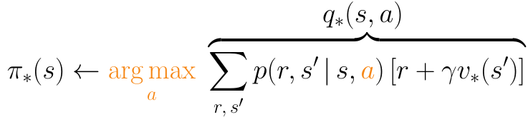
Determining optimal policy from v*(s), q*(s,a)
If q* is known – how to recover the optimal policy?
If v* is known – how to recover the optimal policy?
Unknown model dynamics → unable to recover optimal policy from v*
Notes:
In fact, one need to recover first an action-value function from this v star using the environment probabilities, precisely in the same way as we did in policy improvement stage.
And by recovering this q* we reduce the problem of recovering the policy from v* to the previos problem, which we already known how to solve.
Not that in a model free setup, when we dont have access to transition probabilites, we are unable to recover an optimal policy solely from v*.
And this is why in a model free setup we could only rely on q*.

Slide 65
Precise evaluation is excessive
Notes:
Well, by now, the one thing is not completely clear.
When we were talking about a solution to the system of bellman expectation equations I said that most of the time we don’t need the precise solution of this system. It is sufficient for us to obtain a good approximation to the solution. Why is it so?
Let look at the small grid world problem

Slide 66
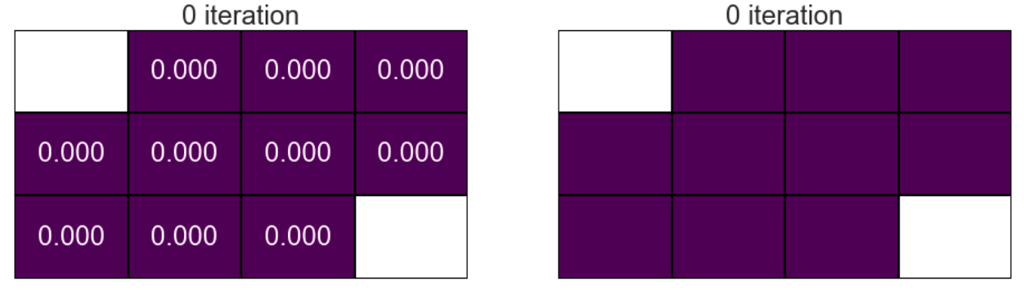
Value function
Greedy policy
Notes:
In this grid world problem, an agent could escape the world through
either of the two terminal states, one in the top left (with reward of -10)
and one in the bottom right (with reward of +10).
For each time tick an agent additionally receives a negative reward of -1,
which motivates an agent to escape as quick as possible.
Left plot corresponds to current value function estimates which are all initialized to zero.
In the right plot you can see which actions are taken by the policy which is greedy with respect to current value function estimates.
That is the policy on the right is an improvement over initial random policy, and this improvement is achieved by acting greedily with respect to value function estimates plotted on the left.
At the very beginning all actions are equally likely, because all state value estimates are equal to each other.

Slide 67
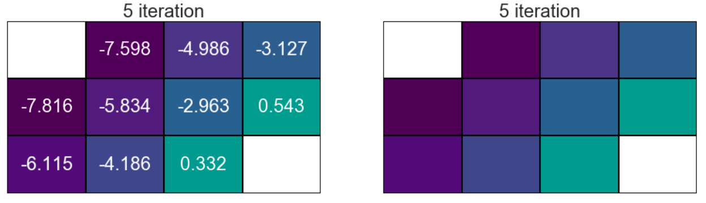
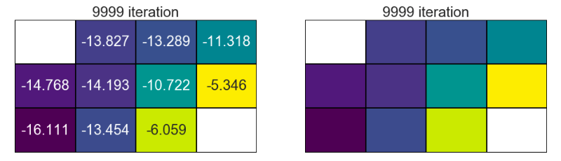
Value function
Greedy policy
Notes:
However after only _five iterations_ of policy evaluation the value of states
are sufficiently accurate to yield the same greedy policy as the precise
solution of the system of bellman expectation equations.
This solution is shown in the last row of plots.
Please note, that values of the precise solution differ a lot from the intermediate step solution obtained after the fifth iteration.
But for policy improvement the absolute state values do not matter as long as the order of such values is the same as in precise solution.
That means that doing all iterations of Policy Evaluation after the fifth one is absolutely useless for subsequent Pimporv step.

Slide 68
Roadmap
Now we know what is
Policy evaluation (based on Bellman expectation eq)
Policy improvement (based on Bellman optimality eq)
The finishing touches:
how to combine them to obtain optimal policy?
Notes:
By now we are familiar with policy evaluation and policy improvement.
We also know, what is the connection of these procedures with Bellman expectation and optimality equations.
We may also surmise that these two procedures are essential to find an optimal policy.
Well, our next topic to discuss is indeed how to use these procedures to obtain the optimal policy.

Slide 69
Generalized Policy Iteration
Notes:
Well, by now, the one thing is not completely clear.
When we were talking about a solution to the system of bellman expectation equations I said that most of the time we don’t need the precise solution of this system. It is sufficient for us to obtain a good approximation to the solution. Why is it so?
Let look at the small grid world problem

Slide 70
The idea of policy and value iterations
Policy evaluation
Policy improvement
Notes:
Generalized policy iteration is one of the most fundamental ideas in RL
This Idea can be recognized in almost any RL algorithm and thus is important to understand.
In its simplest form it tells us that interleaving policy iteration with policy improvement will eventually make our policy an optimal one.
In fact, when we think a little bit about these procedures we realize they are both competing and cooperating.
Why do they compete is self evident. That is,
When we evaluate a policy, we make it no longer to be greedy with respect to its value function.
And when we make a policy greedy with respect to it’s value function we _change_ it’s value function.
This competing behaviour is all the more interesting in that it eventually drives
the policy to become an optimal one, that is to satisfy the bellman expectation equation.
And that is why one could say these two procedures also cooperate with each other.

Slide 71
The idea of policy and value iterations
Generalized policy iteration
Evaluate given policy
Improve policy by acting greedily w.r.t. to its value function
Policy evaluation
Policy improvement
Notes:
But, note that this generalized policy iteration idea does not tell us
how many times should we call policy evaluation procedure
in between of policy improvement calls,
in what order should we update state values and so on.
In theory all these details are not important as long as PE and PI continue to interact with each other.
In that sense the GPI is a very robust idea. What do I mean by that robustness? Well,
– GPI result policy does NOT depend on initialization
– It is NOT susceptible to local optimas
– It does NOT need complete policy evaluation.
That is, evaluation is need not be complete
neither in a sense of updating all states during the PE procedure
nor in a sense of complete convergence of policy evaluation
– It alsp does NOT need to improve policy in all states at any particular step
as long as it is guaranteed that policy will be updated in each and every state once in a while.
So, just for an example of what does GPI allow one to do, think of updating _only_one_ state at each policy evaluation step.
And GPI will converge to globally optimal policy. To make things even more interesting, think about updating it in a _random_ direction, which is correct only in the expectation!
And GPI again will converge to globally optimal policy.
Isn't it impressive, that even under these conditions GPI is guaranteed to works well?
Surely, in practice it will converge the faster the less obstacles it encounters.

Slide 72
The idea of policy and value iterations
Generalized policy iteration
Evaluate given policy
Improve policy by acting greedily w.r.t. to its value function
Policy evaluation
Policy improvement
Robustness:
No dependence on initialization
No need in complete policy evaluation (states / converg.)
No need in exhaustive update (states)
Example of update robustness:
Update only one state at a time
in a random direction
that is correct only in a expectation
Notes:
But, note that this generalized policy iteration idea does not tell us
how many times should we call policy evaluation procedure
in between of policy improvement calls,
in what order should we update state values and so on.
In theory all these details are not important as long as PE and PI continue to interact with each other.
In that sense the GPI is a very robust idea. What do I mean by that robustness? Well,
– GPI result policy does NOT depend on initialization
– It is NOT susceptible to local optimas
– It does NOT need complete policy evaluation.
That is, evaluation is need not be complete
neither in a sense of updating all states during the PE procedure
nor in a sense of complete convergence of policy evaluation
– It alsp does NOT need to improve policy in all states at any particular step
as long as it is guaranteed that policy will be updated in each and every state once in a while.
So, just for an example of what does GPI allow one to do, think of updating _only_one_ state at each policy evaluation step.
And GPI will converge to globally optimal policy. To make things even more interesting, think about updating it in a _random_ direction, which is correct only in the expectation!
And GPI again will converge to globally optimal policy.
Isn't it impressive, that even under these conditions GPI is guaranteed to works well?
Surely, in practice it will converge the faster the less obstacles it encounters.

Slide 73
The idea of policy and value iterations
Generalized policy iteration
Evaluate given policy
Improve policy by acting greedily w.r.t. to its value function
Policy evaluation
Policy improvement
Policy iteration
Evaluate policy until convergence (with some tolerance)
Improve policy
Value iteration
Evaluate policy only with single iteration
Improve policy
Notes:
To further get you a bit of intuition of how different could GPI versions be
we are going to talk about two extreme instances of GPI.
The first one is called Policy Iteration
The second is called Value iteration.
These two approaches differ in how Policy evaluation stage is performed.
In brief, PI requires precise evaluation of policy before each policy improvement.
That is, one need to evaluate a policy until a numerical
convergence of it’s state values before doing a single policy improvement.
At the other extreme, consider an algorithm which performs only one
iteration of policy evaluation between any two successive calls of policy improvement procedure.
This latter algorithm is called Value iteration and is also a very widespread in use.

Slide 74
Policy iteration
Notes:
Well, by now, the one thing is not completely clear.
When we were talking about a solution to the system of bellman expectation equations I said that most of the time we don’t need the precise solution of this system. It is sufficient for us to obtain a good approximation to the solution. Why is it so?
Let look at the small grid world problem

Slide 75
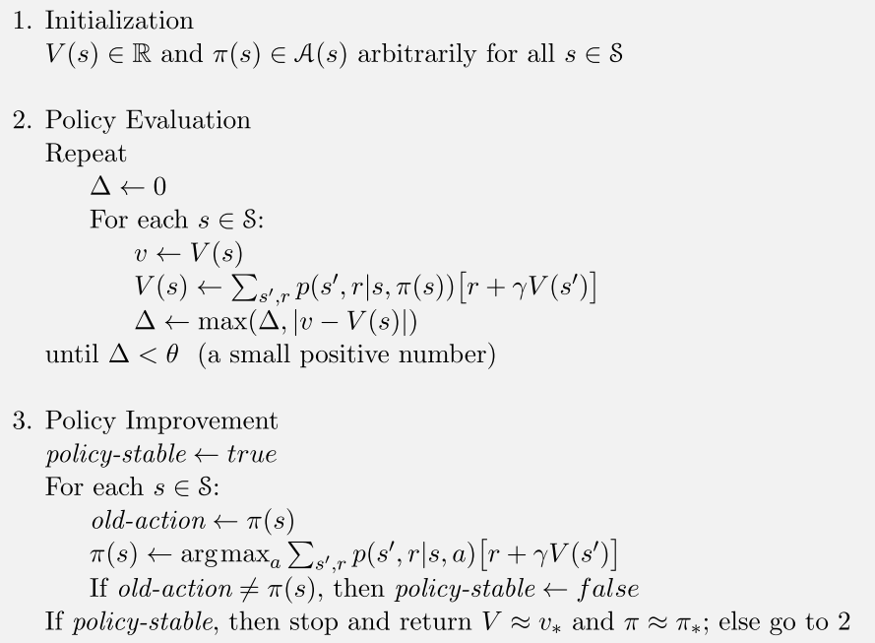
Policy iteration: scheme
Bellman expectation equation for v(s)
q(s,a)
Notes:
On this slide you can see a pseudocode of policy iteration algorithm, consisting of three stages.
The first stage is an initialization of state values. In this stage it is important to initialize value of all terminal state equal to zero.
The second stage is basically a policy evaluation procedure which we have already encountered before.
When we do PE as part of PI algorithm, we perform PE iterations until all state values converge.
But because PE procedure is inherently formulated in an iterative way,
the precise convergence is possible only in the limit, that is after infinite number of iterations.
Thus we allow the PE to converge with some tolerance theta,
that is we stop when maximum amount of update among state values is less then theta.
The third stage is the already familiar to us Policy Improvement procedure, with the only extension.
In particular, after PI procedure we check whether new policy is equal to the old one.
If it is equal, then the state values of these policies are also equal,
and thus we have found an optimal policy which satisfies the bellman optimality equation.
If this is not the case, then we need one more PE and one more subsequent PI.

Slide 76
Value iteration
Notes:
Well, by now, the one thing is not completely clear.
When we were talking about a solution to the system of bellman expectation equations I said that most of the time we don’t need the precise solution of this system. It is sufficient for us to obtain a good approximation to the solution. Why is it so?
Let look at the small grid world problem

Slide 77
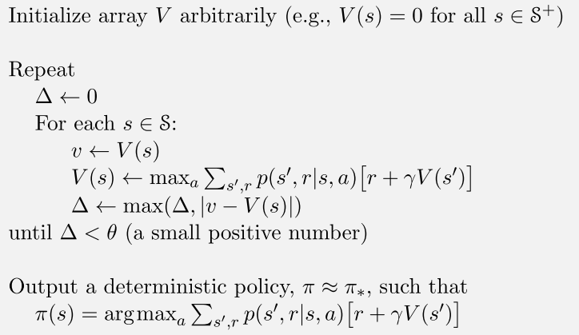
Value iteration
Bellman optimality equation for v(s)
Notes:
Another very important instance of GPI is Value iteration.
In fact keeping aside all bookkeeping
such as state value initialization and termination criteria,
value iteration is essentially a one line assignment.
This assignment effectively combines one truncated step of policy evaluation and full policy improvement step.
One intuition about this assignment is that it is precisely
equal to the bellman optimality equation for v* turned into assignment operation.
A distinctive feature of this algorithm is that it does not
explicitly store the probabilities of actions for each state.
That is, it does not require an explicit policy to perform iterations.
The policy, however, could be recovered from value function
using the argmax of q-function which in turn
is recovered from value estimates and transition probabilites.
This policy recovering step is a very final step in this algorithm.
Please, note that in any intermediate step of this algorithm
the computed value function may _not_ correspond to any possible particular policy.
That is, there may be no policy at all that has such value function.
No policy pi with v pi equal to v from value iteration step.
And this is so by design, because any intermediate
V function is just an approximation of optimal V*, but not V pi for some policy
? Most of these value functions do not correspond to any policy. ?
Value function updates can be unrepresentative of _any_ policy.

Slide 78
Value iteration (VI) vs. Policy iteration (PI)
VI is faster per iteration – O(|A||S|²)
VI requires many iterations
PI is slower per iteration – O(|A||S|² + |S|³)
PI requires few iterations
No silver bullet → experiment with # of steps spent in policy evaluation phase to find the best
Notes:
Well, we have introduced and discussed two extreme
approaches to finding optimal policy with Dynamic Programming.
One is Policy iteration and One is Value iteration.
They are extreme in a sense of how much time is spent in policy evaluation phase.
In Policy iteration one is required to do many iterations of policy evaluation, while in Value iteration one needs to do only one such iteration.
Two these approaches are fairly important because
some of the algorithms you are to encounter during this course
are in fact instances of Policy and Value iteration
applied to action value function instead of state value function.
But how to compare two these approaches? Which one is better? Well, this is a difficult question without a clear answer.
VI is faster then PI per iteration, but requires much more iterations than PI.
When I say @iteration@ I mean updating value of each state with one line assignemnt for VI
And performing full PE step followed by Policy Improvement step for PI.
One might think that truth is somewhere in between of these two extreme approaches.
And this is a fruitful idea. In general, it might be useful to experiment with number of iterations of PE.
Somewhere between one iteration, which corresponds to VI,
and infinite number of iterations, which corresponds to PI,
there might be a best possible algorithm for your task at hand.
This concept of intermediate number of iterations, say k iterations,
spent in PE, has its own name. It is called Modified Policy Iteration.
And as I said previously this may be the way to go for you particular application.

